Slide 1

Prayer Cycle
One Hour of Guided Prayer for Wuhan

Slide 2
The
Lord’s
Prayer
5 Minutes
    Our Father, who art in heaven, hallowed be Thy name
    Thank God for who He is and His abundant faithfulness to the Wuhanese
    Thy Kingdom come, Thy will be done on earth as it is in heaven
    Pray for God’s rule and reign to become a reality in Wuhan
    Give us this day our daily bread
    Pray for God’s daily provision for the Wuhanese
    Forgive us our trespasses as we forgive those who have trespassed against us
    Pray the Wuhanese forgive those who have wronged them
    Lead us not into temptation
    Ask for God to guide the Wuhanese in ‘paths of righteousness for His name’s sake’
    Deliver us from evil
    Pray for God to protect the Wuhanese against any of Satan’s strategies

Slide 3
Waiting
Prayer
5 Minutes
Spend time asking the Lord what you should pray for during this hour of prayer, e.g. Chinese government, persecution, families, finances, relationships, churches, gospel sowing, miracles, etc.

Slide 4
Scripture Prayer
5 Minutes
John 14:6
“Jesus answered, ‘I am the way and the truth and the life. No one comes to the Father except through Me.’”
Ezekiel 11:19-20
“I will give them an undivided heart and put a new spirit in them; I will remove from them their heart of stone and give them a heart of flesh. Then they will follow My decrees and be careful to keep My laws. They will be My people, and I will be their God.”
Jeremiah 29:13
        “You will seek Me and find Me when you seek Me with all your heart.”
2 Corinthians 4:6
“For God, who said, ‘Let light shine out of darkness,’ made his light shine in our hearts to give us the light of the knowledge of God’s glory displayed in the face of Christ.”
1 Timothy 2:1-4
“I urge, then, first of all, that petitions, prayers, intercession and thanksgiving be made for all people—for kings and all those in authority, that we may live peaceful and quiet lives in all godliness and holiness. This is good, and pleases God our Savior, who wants all people to be saved and to come to a knowledge of the truth.”

Slide 5
Intercessory
Prayer
5 Minutes
On behalf of the Wuhanese, please pray for following:
University Students: Wuhan has more than one million students at institutes of higher learning.
Pray they will find the Truth in Jesus.
Pray for open doors for the gospel despite the restrictions at universities.
Pray that every student in Wuhan finds God and takes Him back to their hometown.
Pray for believing students to prioritize God’s Kingdom over worldly success.
Ask God to raise up workers who will minister to the international students in Wuhan.
Pray for students to be equipped to make disciples in China and abroad.
COVID-19: Wuhan was the epicenter of the virus.
When COVID struck Wuhan, local church leaders called for prayer and fasting for the city. Thank God that more people prayed for Wuhan in that time than in any other time in history, maybe as many as one billion people.
Thank God that many churches in Wuhan rose up to minister to people as COVID struck the city: giving out masks, food distribution, prayer, and encouragement.
Thank God that many people not interested in spiritual things began to inquire about God as the disease struck.
Pray that as people in Wuhan recover from COVID, they would continue to seek answers to the deeper questions of life triggered by the outbreak, and ultimately find God.
  Wuhan is a transportation crossroads for China (rivers, trains, airport, and highways).
  Pray that the gospel will go out to all corners of the country from Wuhan.

Slide 6
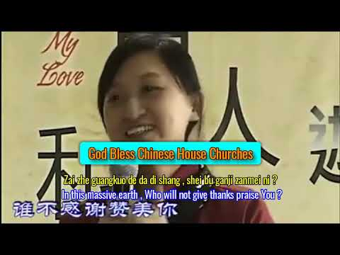
Worship
Prayer
5 Minutes
Click the video to watch or visit
https://youtu.be/C75vM3LGJz0

Slide 7
Intercessory
Prayer
5 Minutes
On behalf of the Wuhanese, please pray for following:
Wuhan's Church Leaders.
Thank God that as pressure on the church increased, leaders remained unified.
Thank God that as pressure on churches increased, more believers were equipped to lead small groups in case the larger churches needed to split and meet in homes.
Pray for church leaders to be bold for the glory of God in the face of restrictions and care more about God’s opinion than man’s.
For leaders to have wisdom to lead their flocks in the midst of increasing restrictions.
For leaders to remain close to God and have healthy families that are God-honoring.
Church leaders are often lonely. Ask God to provide the encouragement, support, and accountability they need to thrive.
Followers of Jesus in Wuhan.
Pray for every believer to take on the Great Commission as their own and see themselves as disciples who make disciples.
Pray for believers to be equipped to be disciples who make disciples.
Ask God to raise up a movement of extraordinary prayer in Wuhan.
Pray for unity among believers.
Pray for revival among Christians in Wuhan, that they would care more about being right with God than impressing other people.
Pray for love to be the supreme virtue outsiders see in God’s people.

Slide 8
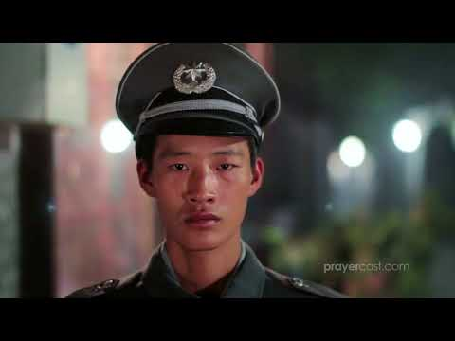
Chinese
Prayer
5 Minutes
Click the video to watch or visit
https://youtu.be/R3140SHt78c
Pray for continued Church growth and pure biblical teaching amid ongoing persecution.
Pray for Jesus' teachings to take deep root in the culture and expose all false religions.
Pray for a renewed value for life to abolish abortion, suicide, abandonment, and human trafficking.

Slide 9
Intercessory
Prayer
5 Minutes
On behalf of the Wuhanese, please pray for following:
Outreach among the Lost in Wuhan.
Ask God to make His Kingdom come to Wuhan, to launch a movement of disciples who make disciples who make disciples.
Pray for believers to be bold and share the love of Christ with those they know.
That believers may have a passion to share the gospel with their friends and family.
Ask God to raise up people of peace, people open to spiritual things like Lydia and Cornelius, who will be baptized, and open their homes up as a house church.
Ask God to raise up thousands of small group leaders who will disciple and shepherd as well as spearhead outreach.
Missions outreach from Wuhan.
Thank God that some churches in Wuhan have sent or are preparing to send missionaries to needy people inside and outside of China.
Ask God to raise up missionaries from Wuhan to go to the nations.
A number of unreached people groups are inside China. Ask God to raise up workers to reach these groups.
Pray that God would supply Wuhanese missionaries with all the training needed to go out and share the Gospel effectively, raise up local leadership, and form new churches.
Pray against the enemies attempts to stop current or future Wuhanese missionaries from going to make disciples outside of the city.

Slide 10
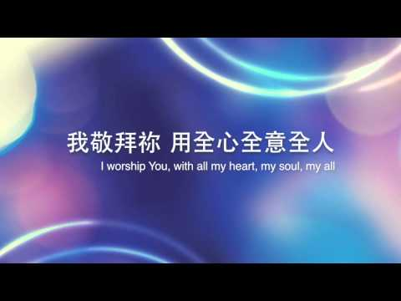
Worship
Prayer
5 Minutes
Click the video to watch or visit
https://youtu.be/Q8er3ORTqrg

Slide 11
Intercessory
Prayer
5 Minutes
On behalf of the Wuhanese, please pray for following:
Marriage and Family
Many churches have marriage and family ministries, and many fathers not interested in God want a happier marriage. Ask God to heal marriages and use marriage ministry to bring people into relationship with Him.
Parents, believers and unbelievers alike, are looking for new ways to parent. Ask God to use this open door to bring more families to Him so they can experience healing and Blessing.
May children learn to better obey and honor their parents, so that it may go well with them and they enjoy a righteous life.
May children of elderly parents honor them by taking care of them.
Thanksgiving and Praise.
Thank God for bringing the gospel to Wuhan and for faithful missionaries both foreign and Chinese who spread it.
Thank God for house churches and official churches throughout the city who are beacons of light in the darkness.
Thank God for bringing the city of Wuhan through the COVID-19 pandemic and for opening hearts to the gospel through it.
Praise God for his great love for every person in Wuhan, his power to change lives, families, communities and the city, defeating the spiritual powers of darkness by the cross, and that He is exalted over Wuhan. The kingdom, power and glory are His.

Slide 12
Scripture Prayer
5 Minutes
2 Timothy 2:2
“And the things you have heard me say in the presence of many witnesses entrust to reliable people who will also be qualified to teach others.”
John 17:21
“...that all of them may be one, Father, just as you are in me and I am in you. May they also be in us so that the world may believe that you have sent me.”
1 John 3:16
“This is how we know what love is: Jesus Christ laid down his life for us. And we ought to lay down our lives for our brothers and sisters.”
Matthew 28:19-20
“Therefore go and make disciples of all nations, baptizing them in the name of the Father and of the Son and of the Holy Spirit, and teaching them to obey everything I have commanded you. And surely I am with you always, to the very end of the age.”
Ephesians 6:13-17
“Stand firm then, with the belt of truth buckled around your waist, with the breastplate of righteousness in place, and with your feet fitted with the readiness that comes from the gospel of peace. In addition to all this, take up the shield of faith, with which you can extinguish all the flaming arrows of the evil one. Take the helmet of salvation and the sword of the Spirit, which is the word of God.”

Slide 13
Listening
Prayer
5 Minutes
Take the next 5 minutes and ask the Spirit of God, “Who would You like me to invite to do this hour of prayer for Wuhan?” e.g. friends, neighbors, coworkers, family, church members, etc.

Slide 14
謝謝
Thank You,
Your prayers will advance the Kingdom of God, build the Church, and begin a movement of disciples who make disciples in Wuhan, and around the world!
BlessWuhan.org

